Slide 1
Classes and Objects

Slide 2
Classes
Define classes
(like we defined functions)
Classes have
Variables
Functions (Methods)

Slide 3
Objects
Classes are a definition
blueprint
Objects are an instance
Building(s)

Slide 4
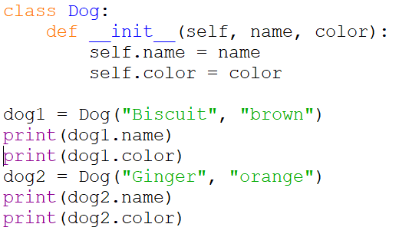
Simple Dog Class Example

Slide 5
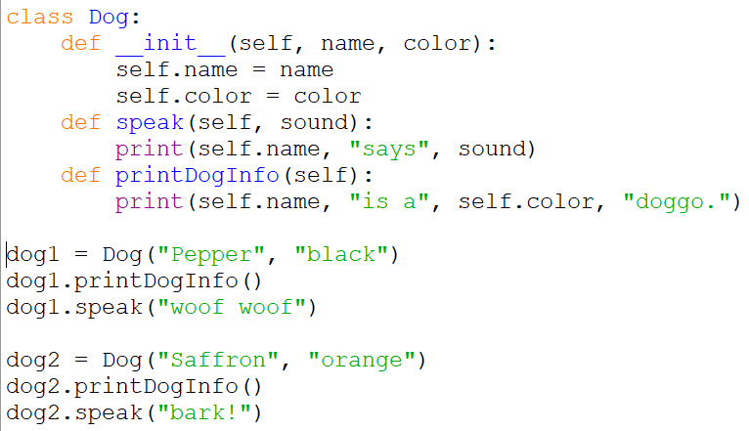
Dog Class with Methods Example

Slide 6

Classes and Dictionaries and Fibonacci

Slide 7
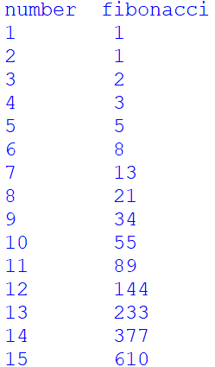
Fibonacci
Fibonacci is a sequence of numbers
fib(n) = fib(n-1) + fib(n-2)
Any Fibonacci number is found by adding the two number before it

Slide 8
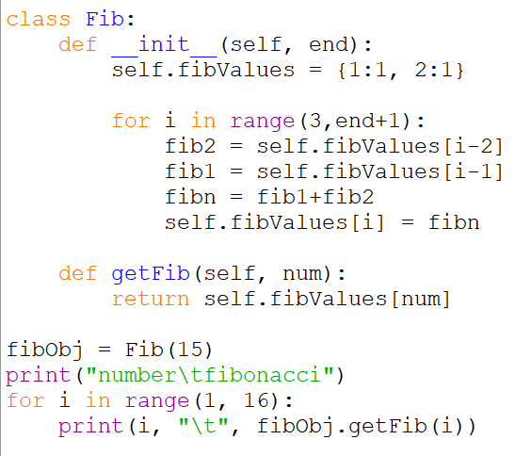
Fibonacci
Class that maps each Fibonacci number to its ordinal position
Takes in an endpoint of how many Fibonacci numbers to store
Has a method to print any Fibonacci number using its ordinal position (which is also its key)

